Slide 1
Handwriting Recognition Using Convolutional Neural Networks
EHB 474E – Introduction to Optimization
Aleyna Demir
Bora Kıran
Elif Cansu Yılmaz
İstanbul Technical University
Spring 2025

Slide 2
Introduction
Handwritten documents are still in use despite digitalization.
Transferring handwritten data to digital format is time-consuming and error-prone.
Automatic recognition of handwritten digits minimizes these problems.

Slide 3
Problem Definition
Goal: Automatic recognition of handwritten digits with high accuracy.
Dataset: MNIST - 28x28 grayscale digit images.
Method: CNN model enhanced with optimization techniques.

Slide 4
Literature Overview
LeNet-5 architecture - pioneering CNN for digit recognition [LeCun, 1998].
Dropout prevents overfitting in neural networks [Srivastava, 2014].
Batch Normalization accelerates stable training [Ioffe & Szegedy, 2015].
Adam optimizer ensures fast, adaptive convergence [Kingma & Ba, 2014].

Slide 5
Methodology - Model Structure
CNN based on LeNet-5 architecture.
Layers: Conv2D + ReLU + BatchNorm + MaxPooling.
Fully connected layers with Dropout regularization.
Softmax output layer for 10-class classification.
Optimizer: Adam - adaptive moment estimation.
Loss Function: Cross Entropy Loss.

Slide 6
Dataset & Training Process
MNIST: 60,000 training, 10,000 test images.
Image size: 28x28, grayscale, one byte.
Training: 10 epochs, batch size of 16.
Performance monitored via accuracy, loss curves, confusion matrix.

Slide 7
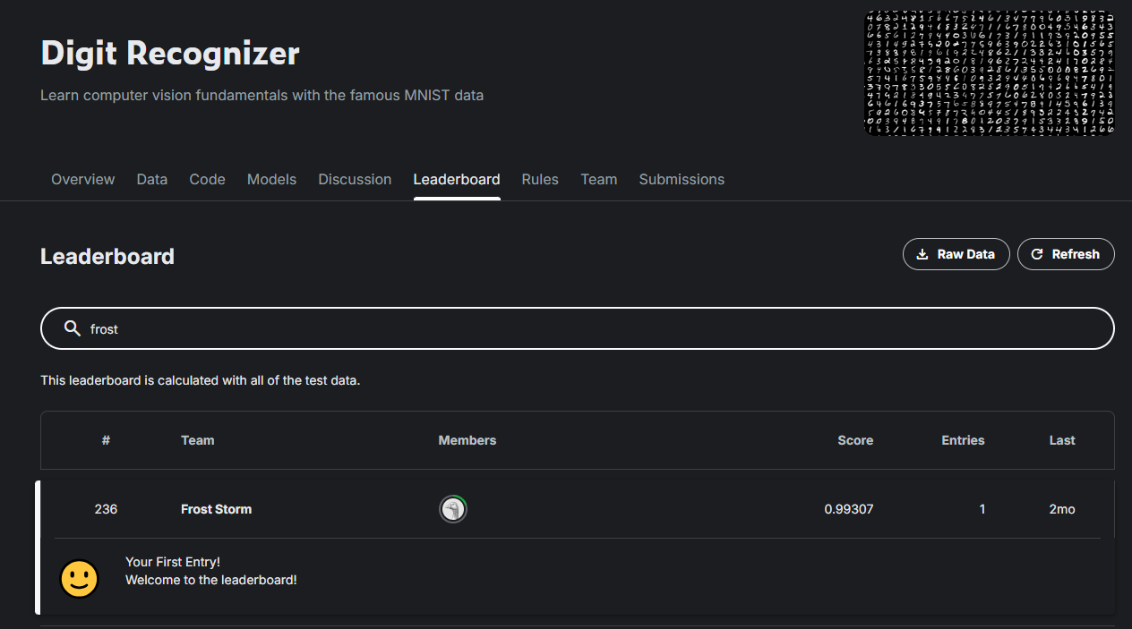
Results

Slide 8
Results
Test accuracy: 99.3%.
Fast and stable convergence with Adam optimizer.
Minor misclassifications in visually similar digits (e.g., 4 & 9).
Model performance is comparable to state-of-the-art results.

Slide 9
Optimization Perspective
Adam ensured efficient, reliable convergence.
Dropout & BatchNorm reduced overfitting.
Convergence towards wide, stable minima in parameter space.

Slide 10
Key Learnings & Contributions
Practical experience in deep learning and optimization.
Hands-on reinforcement of theoretical knowledge.
Improved engineering mindset and teamwork skills.

Slide 11
Future Work
Testing alternative optimization algorithms.
Hyperparameter optimization.
Applying data augmentation techniques.
Evaluating on more complex, diverse datasets.

Slide 12

Thank You

